Slide 1
The Battle For the Residential Edge The Importance of the IoT Hub
Greg Whelan
Principal
Greywale Insights
gwhelan@greywale.com

Slide 2
Greywale Insights All Rights Reserved

Slide 3
The Ecosystem
Quick Overview of the Network
Deployment scenarios and their ecosystem impact
Greywale Insights All Rights Reserved

Slide 4
Broadband Ecosystem
Greywale Insights All Rights Reserved

Slide 5
The Battle Grounds
WebCo
1
Front 1
NetCo1
Battle for Same Customers
Battle for Same Customers
WebCo
2
NetCo
2
Front 2
Figure 2
The Battleground
Greywale Insights All Rights Reserved

Slide 6
Broadband Today
Revenue
Revenues are unbalanced and do not fairly compensate Access Provider
Revenue
Brand Awareness
Customer’s experience is dominated by Web Companies Brand
Brand Awareness
Traffic
Yet, Access Provider sees revenue-less traffic and receive all 1-800 support calls
1-800 Support Calls
Greywale Insights All Rights Reserved

Slide 7
The Network: Wicked Simple View
Core Switching Center,
Metro Switching Center, (Your City)
Central Office
(Your town)
Access
You are here
DC
Greywale Insights All Rights Reserved

Slide 8
Over-the-Top Limitations
DC
CDN
Cache
CDN
(e.g., Akamai)
CDN
Cache
CDN
Cache
Last “50 Miles” is Best Effort ONLY
Greywale Insights All Rights Reserved

Slide 9
The Network
Core Switching Center,
Metro Switching Center, (Your City)
Central Office
(Your town)
Access
Core
Net Co
Metro
Net Co
(Middle Mile)
Access
Net Co
Greywale Insights All Rights Reserved

Slide 10
Broadband Evolution Retail Acquired Wi-Fi Gateway
The Network
The Home
Core
Metro
(Middle Mile)
Access
(Last Mile)
ONT or
Modem
GW
(Wi-Fi)
Revenues are still unbalanced and do not fairly compensate Access Provider
Customer’s experience is still dominated by Web Companies Brand
Yet, Access Provider still sees revenue-less traffic and receive all 1-800 support calls
Greywale Insights All Rights Reserved

Slide 11
Broadband Evolution SP Integrated Gateway
The Network
The Home
Access
(Last Mile)
ONT or
Modem
Gateway
(Wi-Fi)
Revenue
Access Provider Doesn’t see increase in revenue
Brand Awareness
Brand is for bandwidth and triple play only
Traffic
Traffic and 1-800 support calls are the same. Yet, AP has visibility to Wi-Fi which will reduce support cost.
1-800 Support Calls
Greywale Insights All Rights Reserved

Slide 12
Broadband Evolution Over-the-Top
The Network
The Home
“Roku”
Access
(Last Mile)
ONT or
Modem
Gateway
(Wi-Fi)
Revenue
Revenues are unbalanced and do not fairly compensate Access Provider
Consumer experience is best effort ONLY.
Revenue
Brand Awareness
Customer’s experience is dominated by Web Companies Brand
Consumer experience is at the mercy of the “Last 50 miles”
Brand Awareness
Traffic
Yet, Access Provider sees revenue-less traffic and receive all 1-800 support calls
1-800 Support Calls
Greywale Insights All Rights Reserved

Slide 13
Broadband Evolution IoT
The Network
The Home
Access
(Last Mile)
ONT or
Modem
Gateway
(Wi-Fi)
“IoT
Hub”
Revenue
Revenues are unbalanced and do not fairly compensate Access Provider
Revenue
Consumer experience is best effort ONLY.
Brand Awareness
Customer’s experience is dominated by Web Companies Brand
Consumer experience is at the mercy of the “Last 50 miles”
Brand Awareness
Traffic
Consumer experience limited to devices and services supported by IoT Hub Provider
Yet, Access Provider sees revenue-less traffic and receive all 1-800 support calls
1-800 Support Calls
Greywale Insights All Rights Reserved

Slide 14
Broadband Evolution IoT
The Network
The Home
Access
(Last Mile)
ONT or
Modem
Gateway
(Wi-Fi)
“IoT
Hub”
Consumer becomes a “Google” Home
Consumer experience is limited to what Google supports
Greywale Insights All Rights Reserved

Slide 15
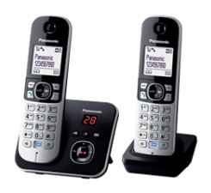
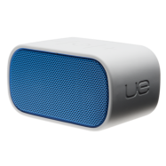
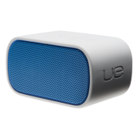
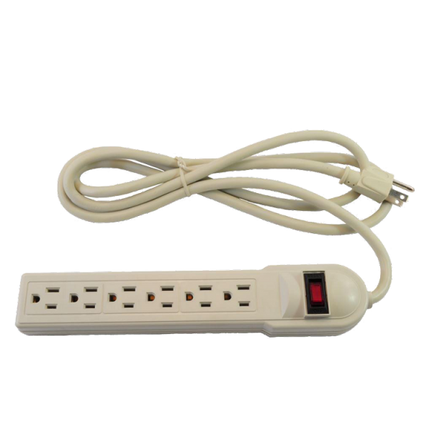
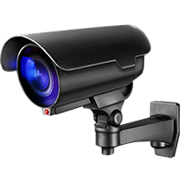
IoT Hub Disparate Consumer Experience
“IoT
Hub” 1
ONT or
Modem
Gateway
(Wi-Fi)
“IoT
Hub” 2
Greywale Insights All Rights Reserved

Slide 16
Access Provider IoT
The Network
The Home
Access
(Last Mile)
ONT or
Modem
Gateway
(Wi-Fi)
“IoT
Hub”
IoT Revenues shift to access provider
Not supported Yet
Customer’s experience shifts to Access provider
Access provider cannot keep up with innovations
This approach does not fairly benefit the entire ecosystem
Greywale Insights All Rights Reserved

Slide 17
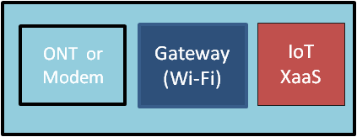
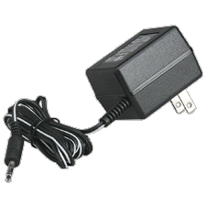
Access Provider as Neutral Host New Wholesale Opportunities
Virtual Machines emulate CPE-based experiences and enable new ones
Web Company CPE migrate to Virtual Machines in resulting in less boxes and less power cords in the home and delivers less intrusive customer experiences
More choices and new experiences increases customer satisfaction and reduces churn
Greywale Insights All Rights Reserved

Slide 18
Benefits to the Ecosystem
Access to broadband customers and no need to build, ship, support CPE devices
Wholesale XaaS revenues provide fair compensation for heavy lift
Greater range of services and devices, less cluttered home, better experience
Greywale Insights All Rights Reserved

Slide 19
Conclusion
Innovations must benefit the entire ecosystem
Each constituent should be fairly compensated for their effort
IoT and Smart Home services represent a large market opportunity
Consumers want ease of use and flexibility of services and devices
Greywale Insights All Rights Reserved

Slide 20
Thank You!
Greg Whelan
Principal
Greywale Insights
gwhelan@greywale.com
Greywale Insights All Rights Reserved

